Slide 1
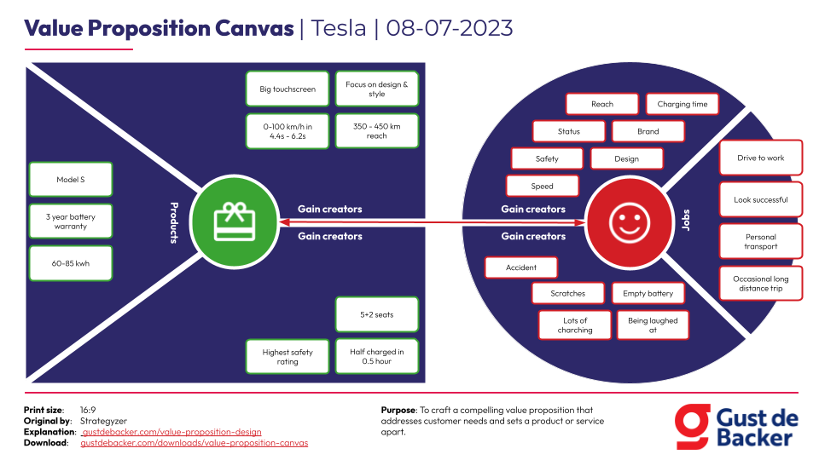

Slide 2
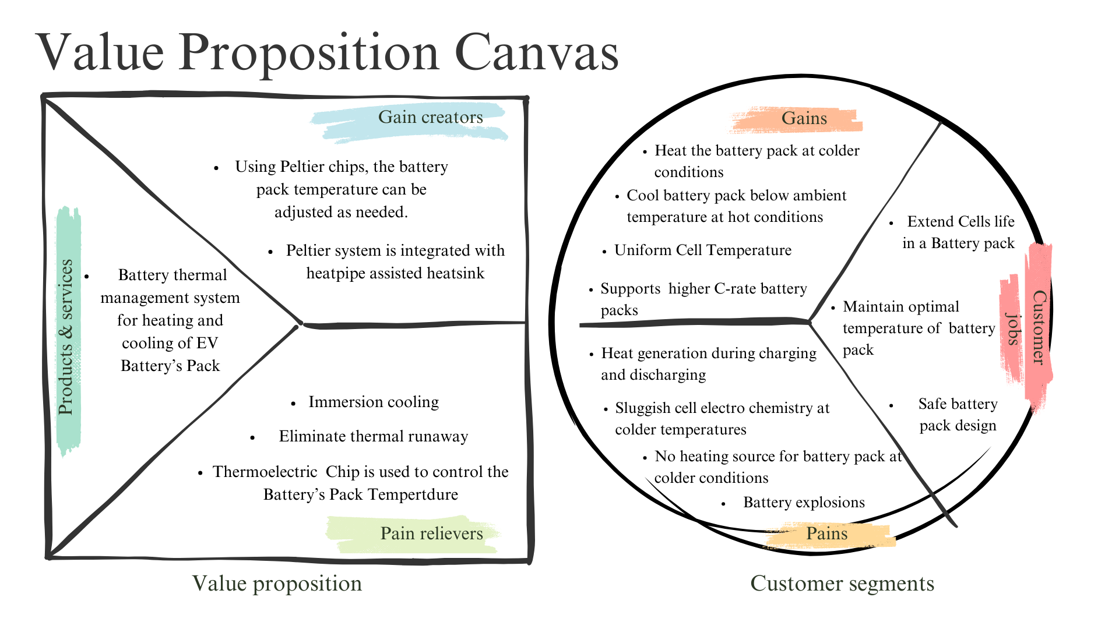

Slide 3
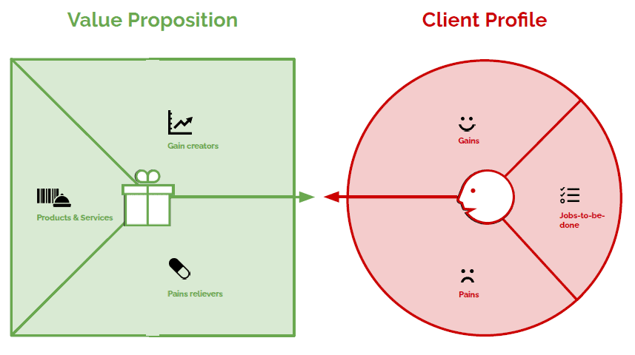
Prolonged battery life
Enhanced Performance
Stable and Safe Battery Operation
Prolonged battery life
Optimized cooling leading
Heat pipe assisted cooling
Safe Battery Operation
Flexibility in system integration
stable
Optimized cooling leading to improved overall efficiency
Customizable thermal management
Compatibility and Standards
Flexibility
Integration support for diverse battery setups
Efficient heat dissipation
preventing overheating
Energy-efficient cooling
Peltier cooling technology
reducing power consumption

Slide 4
Products & Services:
Heat pipe assisted cooling systems.
Peltier cooling technology.
Customizable thermal management solutions.
Integration support for diverse battery setups.
Gains:
Battery Manufacturers: Streamlined integration, prolonged battery life.
EV Manufacturers: Enhanced vehicle performance, prolonged battery lifespan.
Renewable Energy Companies: Stable and safe energy storage solutions.
Consumer Electronics Manufacturers: Improved device performance, longer battery life.
Pains:
Battery Manufacturers: Complex integration of cooling systems into battery designs.
EV Manufacturers: Overheating risks affecting vehicle performance.
Renewable Energy Companies: Lack of efficient thermal management impacting storage systems.
Consumer Electronics Manufacturers: Limited options for effective battery cooling in compact devices.
Pain Relievers:
Efficient heat dissipation, preventing overheating.
Simplified integration reducing design complexities.
Energy-efficient cooling, reducing power consumption.
Ensured safety through precise temperature regulation.
Customer Segment:
Battery Manufacturers: Seeking efficient thermal management solutions.
Electric Vehicle (EV) Manufacturers: Needing reliable battery cooling systems.
Renewable Energy Companies: Requiring effective battery thermal solutions for storage.
Consumer Electronics Manufacturers: Seeking improved battery performance.
Jobs to be Done:
Gain Creators:
Prolonged battery life and enhanced performance.
Flexibility in system integration for various applications.
Optimized cooling leading to improved overall efficiency.
Assurance of stable and safe battery operation.

